Slide 1
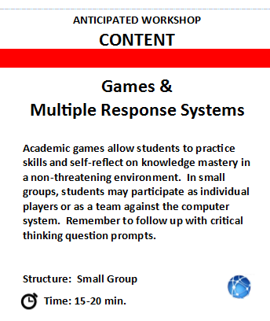
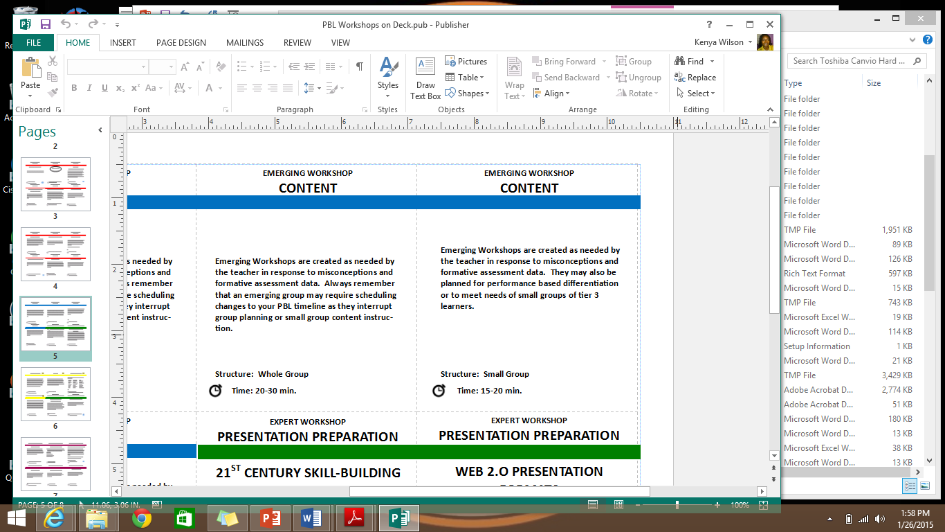
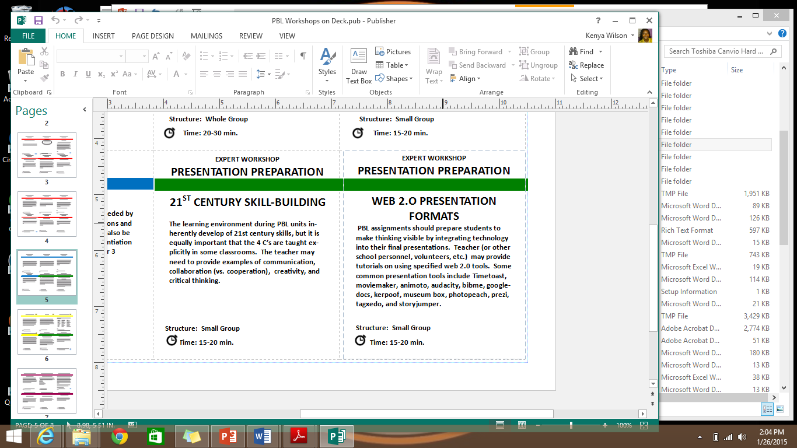
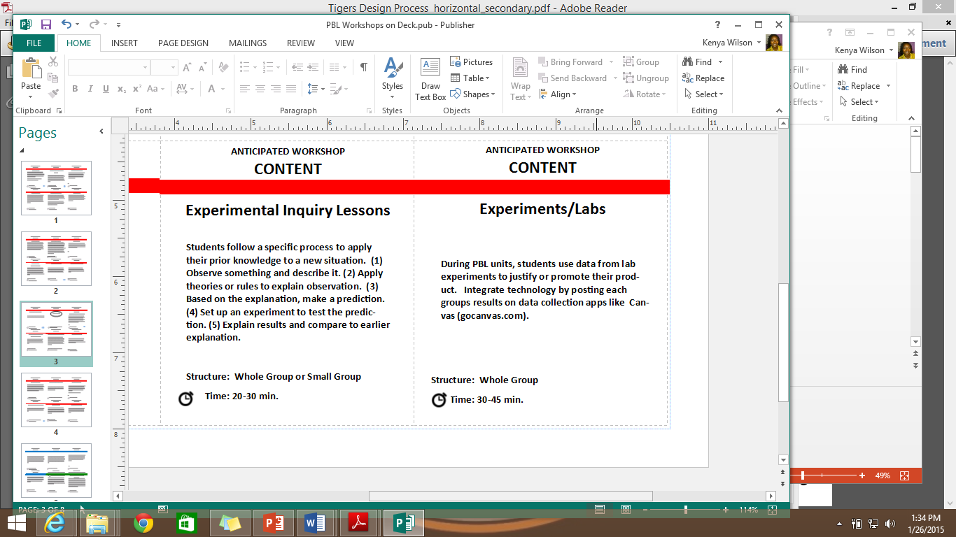
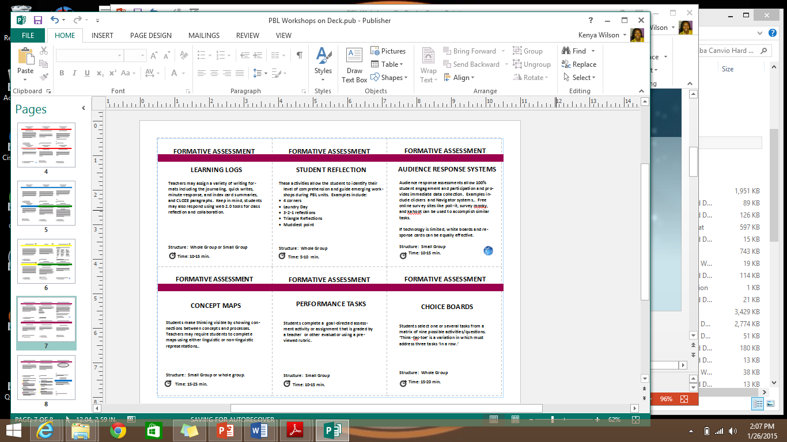
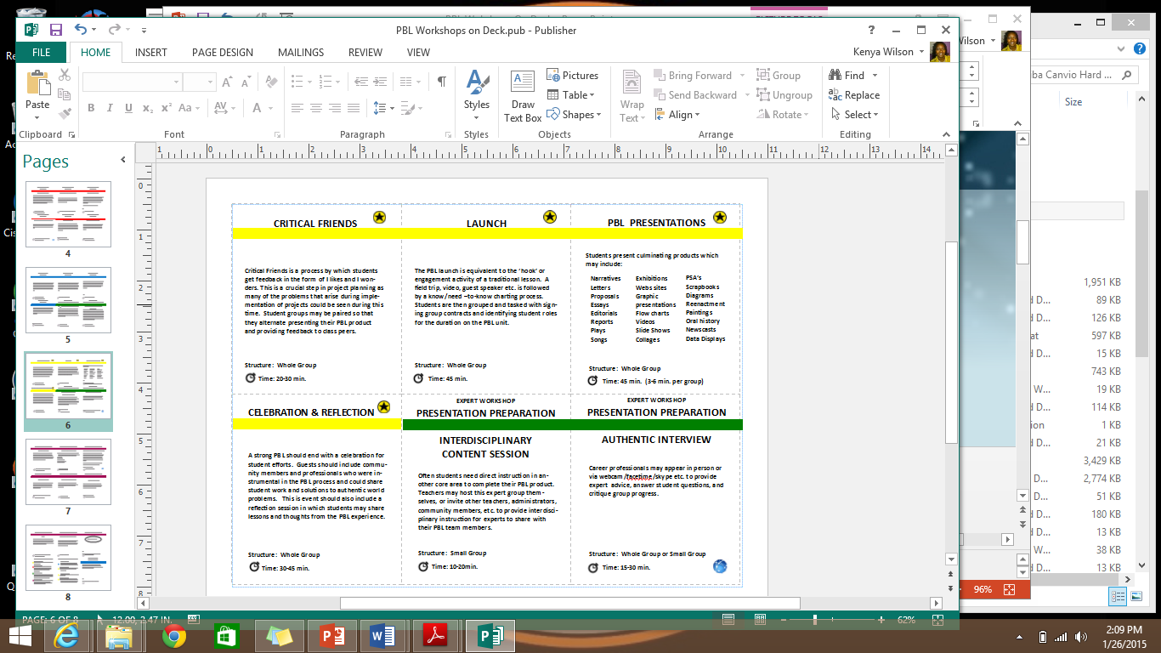
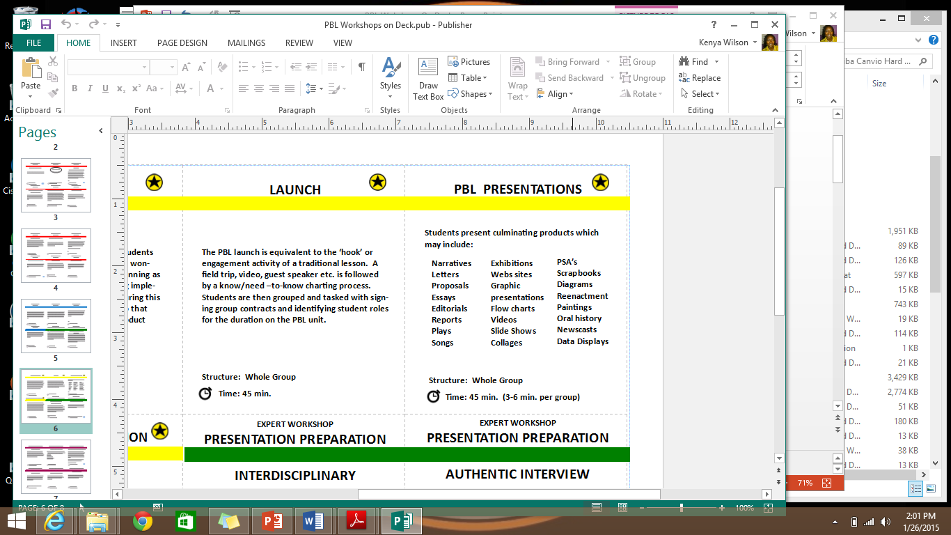
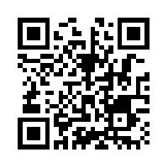
PBL Workshops On Deck
Kenya Wilson, M.Ed.
PBL Instructional Coach/Science Specialist
www.tinyurl.com/PBLdeck

Slide 2
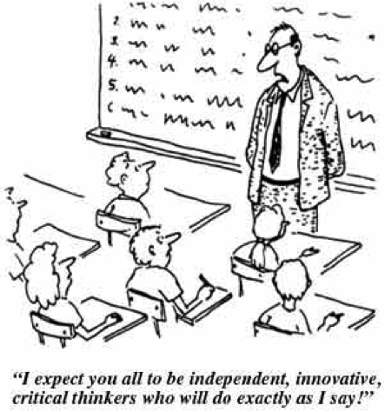
The Great Debate
Content
vs.
21st Century Skills
Join us at:
http://tinyurl.com/PBLdeck

Slide 3
Today’s Goals
Define Project-Based Learning
Identify Components of PBL
Navigate your PBL Workshop Planning Deck
PBL Workshops On Deck

Slide 4

What is Project-Based Learning?
PBL Workshops On Deck
Notes:
Purposeful learning, real-world.
Examples from partiipants.

Slide 5

Project-Based Learning is a teaching method in which students gain knowledge and skills by working for an extended period of time to investigate and respond to a complex question, problem, or challenge.
-from the Buck Institute for Education www.bie.org
Teaching method ………………………….. strategy
Knowledge and skills ……………..……... standards
Extended period of time ………………….... pacing
Investigate and respond ……....……… engagement
Complex question, problem, or challenge .….. rigor
PBL Workshops On Deck

Slide 6

PBL is quality instruction
& best practices!!!
PBL is not:
Project time at the end of a unit
Extra credit or the dessert of a unit
An independent homework assignment
“Extra” work that takes time from real instruction
Busy-work for students/Grading time for teachers
PBL Workshops On Deck

Slide 7

Today’s Goals
Define Project-Based Learning
Identify Components of PBL
Navigate your PBL Workshop Planning Deck
PBL Workshops On Deck

Slide 8
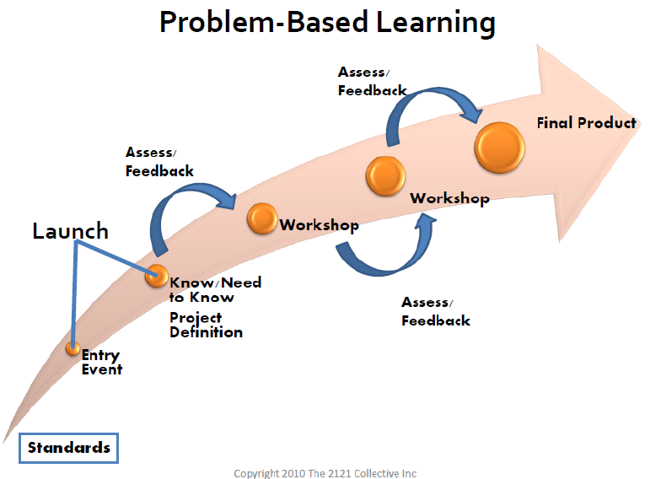
Unit Sequence
PBL Workshops On Deck
Notes:
Purposeful learning, real-world.
Examples from partiipants.

Slide 9
Identify your Standards
Physical Education
3.4 Physical activity and health. The student knows the benefits from involvement in daily physical activity and factors that affect physical performance. The student is expected to:
(A) describe the long term effects of physical activity on
the heart;
(B) distinguish between aerobic and anaerobic activities;
(C) identify foods that increase or reduce bodily functions;
(D) identify principles of good posture and its impact on
physical activity
PBL Workshops On Deck

Slide 10
Unpack your Standards
(A) describe the long term effects of physical activity on the heart;
(B) distinguish between aerobic and anaerobic activities;
(C) identify foods that increase or reduce bodily functions;
(D) identify principles of good posture and its impact on physical activity
muscle, pumps blood, vital, define physical activity, heart rate
oxygen, cramping, prefixes
energy, food groups, dietary decision-making
skeleton, safety,
PBL Workshops On Deck

Slide 11
Unit Sequence
(Entry Document)
PBL Workshops On Deck
Notes:
Purposeful learning, real-world.
Examples from partiipants.

Slide 12

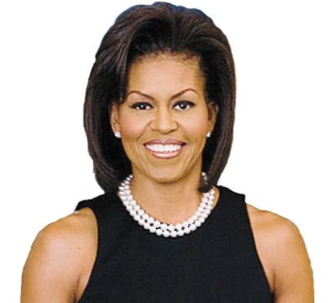
The Launch
Hello students,
As you know, another U.S. President has been elected and I will be leaving my duties in the White House. One of those responsibilities has been leading the nation’s health initiative. It is extremely important that our work in cardiac awareness be continued. Therefore, the US Department of Health is seeking student proposals and presentations that will teach Americans the importance of heart health and activity. Submissions should include creative posters and lively video demonstrations. The deadline is …
PBL Workshops On Deck

Slide 13
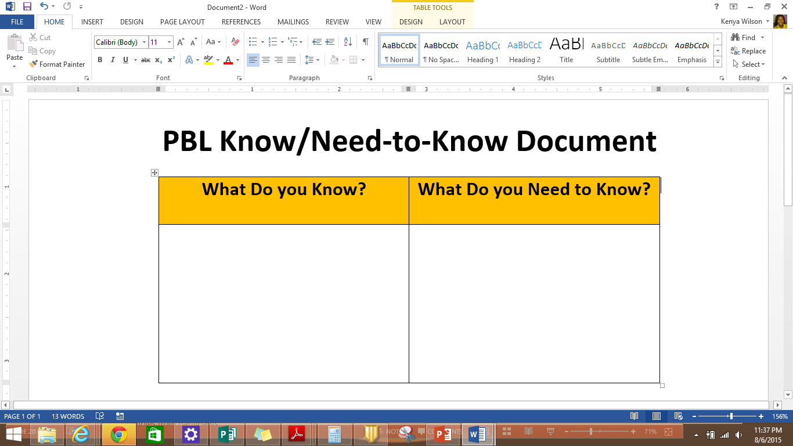
The Launch
Prior Knowledge
Vocabulary
Due dates etc. from entry
Presentation formats
…
Knowledge and skills
PBL Workshops On Deck

Slide 14
Unit Sequence
PBL Workshops On Deck
Notes:
Purposeful learning, real-world.
Examples from partiipants.

Slide 15
Workshops
Instructional units used to teach and guide the unit. Workshops focus on-
Content
21st Century skills
Critical Thinking, Collaboration,
Creativity, Communication
CCR (career & college readiness)
PBL logistics
PBL Workshops On Deck

Slide 16
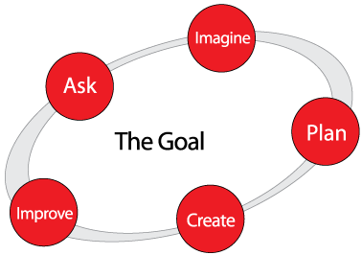
Workshops: More Than TEKS!
Engineering Design Process
PBL Workshops On Deck

Slide 17
Unit Sequence
PBL Workshops On Deck
Notes:
Purposeful learning, real-world.
Examples from partiipants.

Slide 18
Today’s Goals
Define Project-Based Learning
Identify Components of PBL
Navigate your PBL Workshop Planning Deck
PBL Workshops On Deck

Slide 19
Let’s Play Cards!
PBL Workshops On Deck
Notes:
Purposeful learning, real-world.
Examples from partiipants.

Slide 20
PBL Deck: Card Key
Launch Card (1)
Critical Friends (1)
PBL Presentation (1)
PBL Celebration (1)
Content Workshops (25)
Expert Workshops (5)
Assessments (9)
Emerging Workshops (5)
Project Time (5)
Deck Key Cards (2)
PBL Workshops On Deck

Slide 21
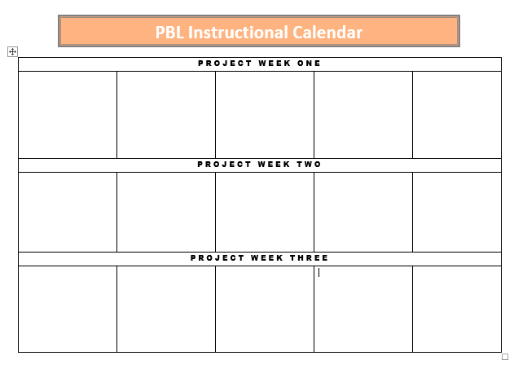
Let’s Practice
Read the PBL Launch document and student expectations provided.
“Play” your yellow cards by placing them into a “used” deck and writing them into your PBL calendar as the first, last, and closing activities.
Launch
Critical
Friends
Presen-tations
PBL Workshops On Deck

Slide 22
Anticipated Workshops
3. With your table team, decide how to best teach the standards provided with the red workshop cards. Write these activities into your PBL calendar. Remember, all small group workshops should have simultaneous PBL project time. Play your red cards by placing them in your “used” deck.
Launch
Critical
Friends
Presen-tations
PBL Workshops On Deck

Slide 23
Formative Assessments
4. Now consider your assessments. You should assess students every two days, at minimum. Play those cards by placing them in the used deck and writing them on your PBL calendar.
Launch
Critical
Friends
Presen-tations
PBL Workshops On Deck

Slide 24
Expert Workshops
5. What other skills may your students need to create their PBL product? These are taught during expert workshops. You’ll need 1-3 expert workshops. Play these cards and write the activities into your calendar.
Launch
Critical
Friends
Presen-tations
PBL Workshops On Deck

Slide 25
Emerging Workshops
6. Emerging workshops can now be placed
Launch
Critical
Friends
Presen-tations
PBL Workshops On Deck

Slide 26
Emerging Workshops
7. Finally, we add in project time.
Launch
Critical
Friends
Presen-tations
PBL Workshops On Deck

Slide 27

Well Done!
PBL Workshops On Deck

Slide 28

Now for your content…
PBL Workshops On Deck

Slide 29
PBL Workshops On Deck
Comments/Questions:
http://tinyurl.com/PBLdeck
Contact me: Kenya.Wilson@sbcglobal.net

